Slide 1
All pair Shortest Path
Submitted by :- dimpal kataniya
Roll no. :- 181210022
Cse 2nd year

Slide 2
All pair Shortest Path
All Pair Shortest Path Problem : Find a shortest path from u to v for every pair of vertices of u and v. Although we can solve this problem by running a single-source algorithm once from each vertex, we usually can solve it faster.
The all pair shortest path algorithm is also known as Floyd-Warshall algorithm is used to find all pair shortest path problem from a given weighted graph.
As a result of this algorithm, it will generate a matrix, which will represent the minimum distance from any node to all other nodes in the graph.

Slide 3
FLOYD-WARSHALL’S ALGORITHM
In all pair shortest path, when a weighted graph is represented by its weight matrix W then objective is to find the distance between every pair of nodes.
We will apply dynamic programming to solve the all pairs shortest path.
In all pair shortest path algorithm, we first decomposed the given problem into sub problems.
In this principle of optimally is used for solving the problem.
It means any sub path of shortest path is a shortest path between the end nodes.

Slide 4
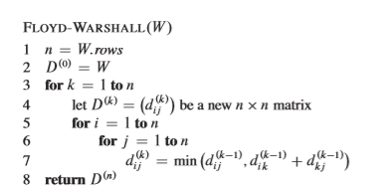
Algorithm :-

Slide 5
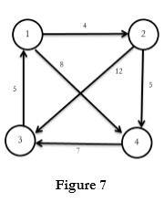
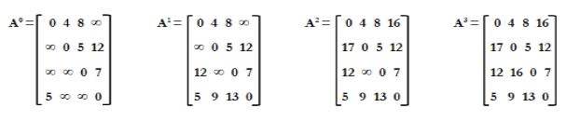
Example problem :-

Slide 6
Time complexity :-
The running time of the Floyd-Warshall algorithm is determined by the triply nested for loops of lines 3–7.
Because each execution of line 7 takes O(1) time, the algorithm runs in time O(n^3).

